Slide 1
An Analytical Placement Algorithm with Routing topology Optimization
Min Wei, Xingyu Tong, Zhijie Cai, Peng Zou, Zhifeng Lin and Jianli Chen
State Key Lab of ASIC & System, Fudan University, Shanghai 200433, China
Center for Discrete Mathematics and Theoretical Computer Science, Fuzhou University, Fuzhou 350108, China
Presenter : Min-Feng Hsieh
Advisor : Ting-Chi Wang
Notes:
上海鐳達晶元智慧科技有限公司
復旦大學專用積體電路與系統國家重點實驗室

Slide 2
Outline
Introduction
Preliminaries

Slide 3
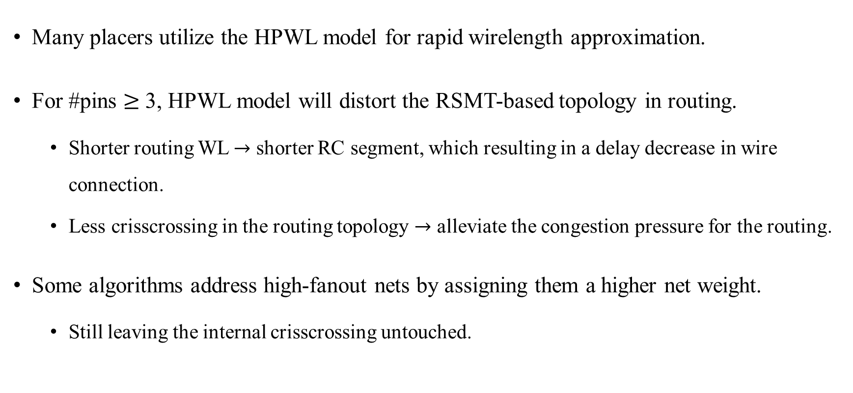
Introduction
Many placers utilize the HPWL model for rapid wirelength approximation.
For #pins $≥$ 3, HPWL model will distort the RSMT-based topology in routing.
Shorter routing WL $→$ shorter RC segment, which resulting in a delay decrease in wire connection.
Less crisscrossing in the routing topology $→$ alleviate the congestion pressure for the routing.
Some algorithms address high-fanout nets by assigning them a higher net weight.
Still leaving the internal crisscrossing untouched.

Slide 4
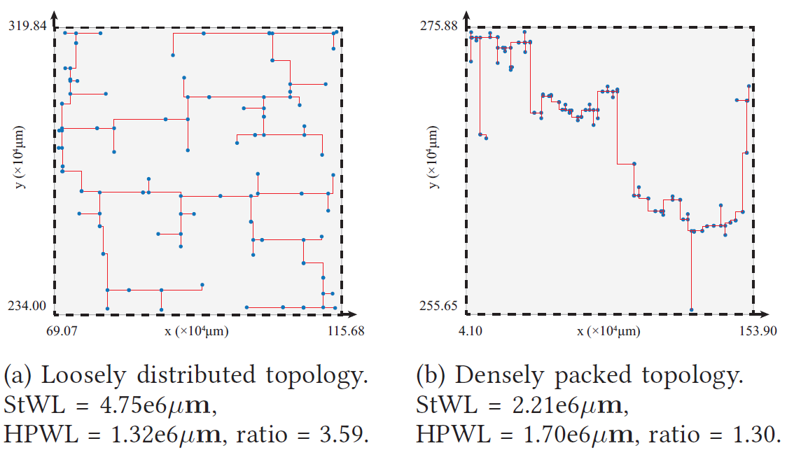
Introduction
The rectilinear Steiner minimal tree (RSMT) is an optimal topology that can accurately approximate the routing wirelength.
StWL: RSMT wirelength
Notes:
圖a的inner point (藍色點)比較稀疏 -> HPWL低，但是StWL高 (因為她的steiner tree遍布整個bounding box)
圖b的inner point (藍色點)比較密集 -> HPWL高，但是StWL低

Slide 5
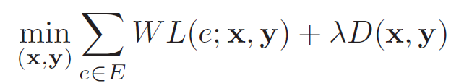
Preliminaries - WL-Driven Analytical Placement
The placers construct a minimization problem of the total wirelength under the cell density constraints.
Objective function:

Slide 6
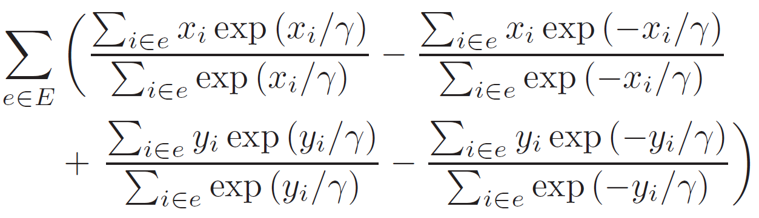
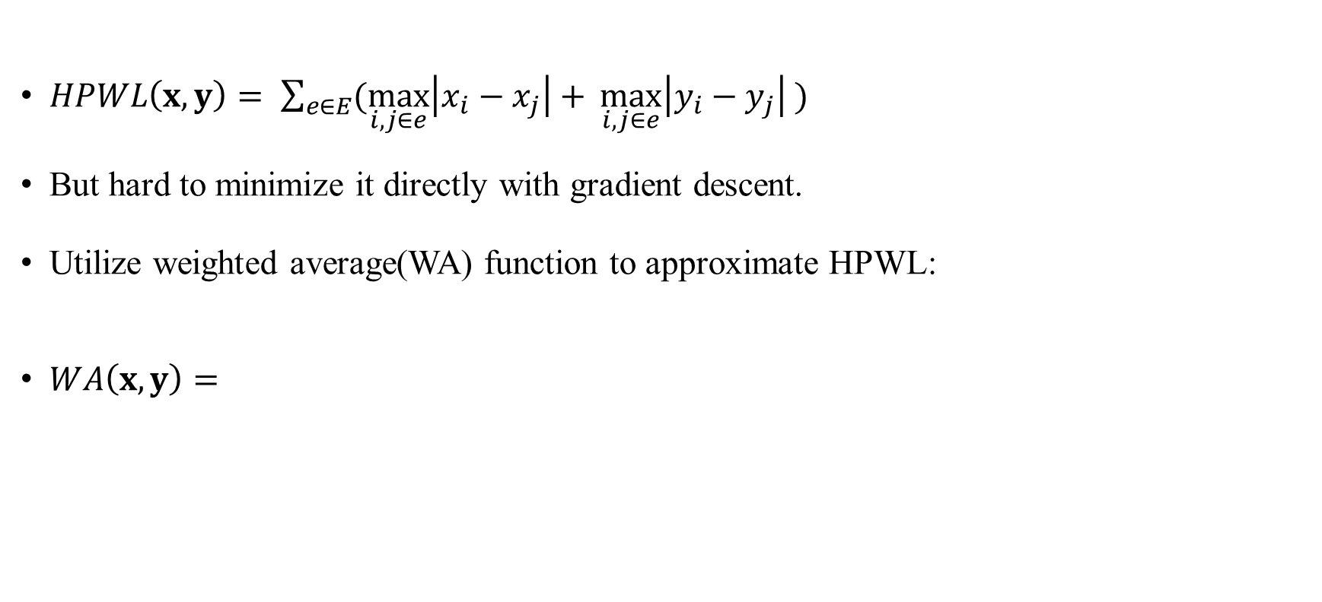


Preliminaries - HPWL Wirelength Model
$HPWL\left(x,y\right)= \sum_{e∈E}{(\max_{i,j∈e}\left|x_{i}−x_{j}\right|+ \max_{i,j∈e}\left|y_{i}−y_{j}\right| )}$
But hard to minimize it directly with gradient descent.
Utilize weighted average(WA) function to approximate HPWL:
$WA\left(x,y\right)=$
$$↑$$
$$γ=maxterm in x\left(y\right)direction$$
$$↑$$
$$γ=minterm in x\left(y\right)direction$$
Notes:
i, j are different pins of the specific net e

Slide 7
Thank you for listening!

